Slide 1

Rentura
By Code of law

Slide 2






Rentura at a Glance
Mission
Technical Evolution
providing fast, affordable, and accessible legal checks of rental contracts through AI
Prior LLMs with limited context and understanding
Now: reliable AI legal analysis with near-human accuracy
Customer Pain Point
Market
Tenants with limited legal knowledge
Expensive and slow legal advice
CAGR of around 25% over the forecast period till 2028 for Global AI contract review software
Our Solution
Team
Rentura checks rental contracts instantly and affordably.
Experience in Python, React, Data Science, Law, Business

Slide 3
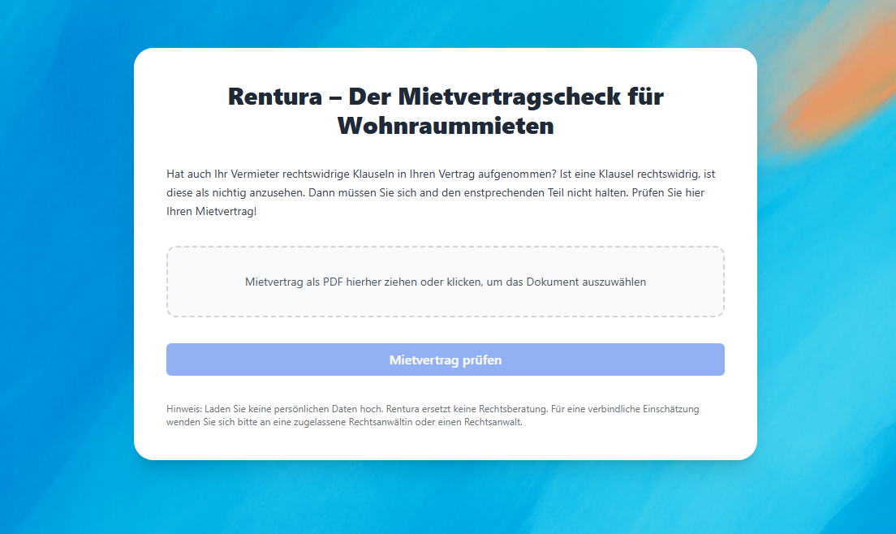



Product and Strategy
Product
PDF text or OCR extraction, GPT legal analysis, automated risk summary generation.
Use Cases
Independent review of rental contracts for individuals and property companies
Prevent legal disputes
Business Model
Pay-Per-Use for B2C (20 €)
Subscription-Based Model for B2B (200 € Monthly for 100 Reviews)

Slide 4
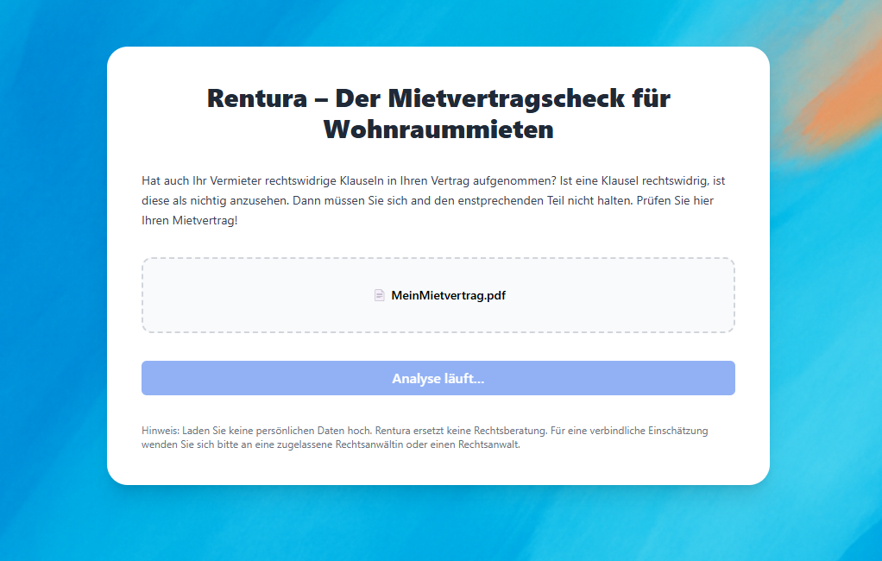
Product and Strategy
Product
PDF text or OCR extraction, GPT legal analysis, automated risk summary generation.
Use Cases
Independent review of rental contracts for individuals and property companies
Prevent legal disputes
Business Model
Pay-Per-Use for B2C (20 €)
Subscription-Based Model for B2B (200 € Monthly for 100 Reviews)

Slide 5
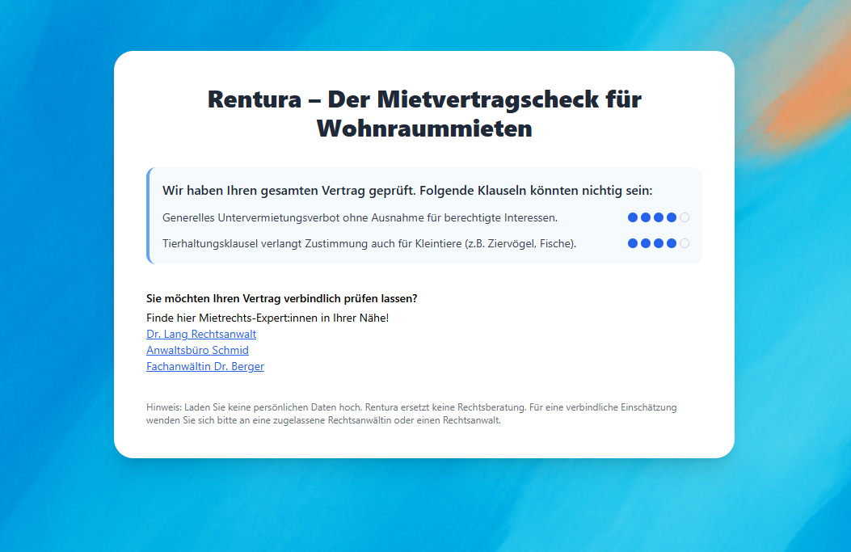
Product and Strategy
Product
PDF text or OCR extraction, GPT legal analysis, automated risk summary generation.
Use Cases
Independent review of rental contracts for individuals and property companies
Prevent legal disputes
Business Model
Pay-Per-Use for B2C (20 €)
Subscription-Based Model for B2B (200 € Monthly for 100 Reviews)

Slide 6

Thank you!

